Slide 1
INTRODUCTION TO WEB DEVELOPMENT - SESSION 1
Katerina Veloska- kveloska@gmail.com

Slide 2
HELLO!
Katerina Veloska
Web developer @Success It
Trainer @SEDC
Former student of Sedc
@SEDC 2018-2019

Slide 3

INTRODUCTION TO THE COURSE
be introduced to problem solving scenarios
be introduced to programming, programmer and algorithms
learn to understand main programming concepts and principal differences
learn about control flows, loops and functions
learn about flowcharts and pseudo-code
@SEDC 2018-2019

Slide 4
THE RESULT OF THE COURSE
understand computers and the web in a nutshell
understand the difference between humans and computers
sharpen skills in approaching and solving problems
understand basic terms and concepts in computer programming
be able to write flowcharts and pseudo-code
@SEDC 2018-2019

Slide 5

AGENDA
Session 1
Introduction to the academy and what it offers, short history about programming and how the web works and Q&A session
Session 2
Problem solving and how humans and machines handle it and introduction to programming, languages and programmers
Session 3
Introduction to basic programming concepts and methodologies and developing a programming mindset through pseudocode and flowcharts
Session 4
How to approach problems and create solutions, the process of making a program and exercises with pseudocode
@SEDC 2018-2019

Slide 6
What about
you?
@SEDC 2018-2019

Slide 7

WHERE ARE WE NOW?
Technology is taking over every aspect of our lives
80% of the developed world uses the internet
The job market for developers is enormous
Strong and open developer community
@SEDC 2018-2019

Slide 8
TIMELINE OF COMPUTERS AND THE WEB
FORTRAN - First compiled programming language
First design of high level language
First programmable computer
C programming language
The term internet is born
First email is sent
1942
1946
1965
1969
1975
1980
ENIAC I - Early general purpose computer
1976
C++ programming language
1936
Concept of program invented
1943
1954
Beginning of the internet
1969
First message sent through the internet
1974
First consumer computers
@SEDC 2018-2019
Notes:
Concept of program inveted by Ada Lovelace
First programmable computer - Z1
First design of high level language - Plankalkül
ENIAC I was huge
Beginning of the internet - Two computers communicated in MIT using packet switching technology
C - Systems programming language
First message was sent from a student at stanford research institute and it was LO, the student wanted to write LOGIN but the system crashed and LO was sent
Term internet is born in CERN, the name coming from huge network of networks ( inter- among many things net - network )
First email is sent by queen elizabeth
C++ - object and structured programming language

Slide 9
TIMELINE OF COMPUTERS AND THE WEB
Personal computer revolution (IMB PC)
TCP/IP becomes standard protocol
Microsoft Windows is released
HTML markup language
Microsoft creates Internet Explorer
The Internet explodes and takes over
1981
1984
1989
1991
1995
1998
1981
MS-DOS operating system
1982
Apple MAC is released
1985
First commercial internet provider
1990
Introduction to the World Wide Web
1995
JAVA and JavaScript are born
1996
Google search engine is born
@SEDC 2018-2019
Notes:
Personal computer revolution - IBM PC - Personal computer
TCP/IP becomes a standard protocol for the internet, and it is still used TODAY
Apple MAC computer is released, a more affordable home computer with GUI than Apple Lisa ( predecessor )
Microsoft windows 1.0
First commercial internet provider of dial-up internet called The World
HTML Markup language invented in CERN to structure web sites ( before website were only text based )
CERN introduces World wide web with its browser WorldWideWeb to the public

Slide 10
TIMELINE OF COMPUTERS AND THE WEB
MAC OSX and Windows XP emerge
Twitter goes online
Windows 7 operating system
IPad tablet computer is released
Facebook goes online
Apple watch introduced
2001
2005
2007
2009
2013
2018
2001
C# programming language
2004
Youtube goes online
2006
IPhone is introduced
2009
Bitcoin is released
2010
Voice recognition breakthrough
2015
WE ARE HERE
@SEDC 2018-2019

Slide 11

But what is the internet? How does it work?
@SEDC 2018-2019

Slide 12
WHAT THE INTERNET IS NOT
It is not ONE SINGLE thing that everyone access
It is not a huge company
We don’t open the internet by opening google
@SEDC 2018-2019

Slide 13
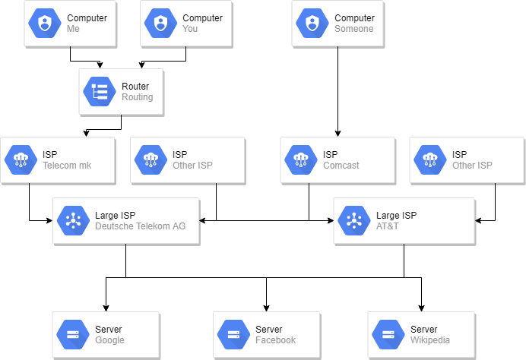
HOW THE INTERNET WORKS
@SEDC 2018-2019

Slide 14

BUT WHAT ABOUT US PROGRAMMERS?
“A programmer is a person who fixes a problem that you don’t know you have, in a way you don’t understand.”
@SEDC 2018-2019

Slide 15
WEB DEVELOPER CATEGORIES
Front End
Developers that create or maintain the client side of the application. This side of the application is everything that the user of the application sees and can interact with
Back End
Developers that create or maintain the server side of the application. This side of the application is all the things that the user can’t see or interact like databases and server mechanisms like request handling and security
@SEDC 2018-2019

Slide 16

Humans VS Computers Which side are you on?

Slide 17
Humans and their brains
The human brain is truly unique
Human brain complexity can be seen only on the cellular level
The nature of the brain and its complexity helps it being unique
Humans approach problems and solving them using the complexity of
the brain.
The ability, speed and quality to acquire and apply knowledge and skills
is known as Intelligence.

Slide 18
Solving problems using a human brain
How do humans approach problems?
The brain creates algorithms to approach problems, however these algorithms aren’t implemented the same way as in computer logic design
Human brain is well adapted to processing analog (visual and audio) input
Human brain is extremely well adapted to pattern matching – even when the pattern is not there
Human brain intelligence has a known and important aspect known as heuristics.
Heuristics enables a person to discover or learn something for themselves.

Slide 19
Solving problems using a computer
How do computers approach problem solving?
Going straight forward with pre-defined algorithms without using
heuristics
Is heuristics applicable in intelligent computer programs?
Way different way of how brain works…
The complexity is much lower…
The ability is much lower…
The speed is much faster

Slide 20
Task : Human vs Computer
Find five problems where humans outmatch computers in finding a solution
Find five problems where computers outmatch humans in finding a solution

Slide 21
FAQ
Questions you might be asking yourself right now
@SEDC 2018-2019

Slide 22
Programer? Developer? What’s the difference?
Programmers program. Developers develop.
@SEDC 2018-2019
Notes:
Programming is writing code
Developing is designing idea to product

Slide 23
Should I become a developer?
Yes, if you like solving problems by making programs. Otherwise no.
@SEDC 2018-2019

Slide 24
How do I learn to program?
By programming!
@SEDC 2018-2019

Slide 25
Do I need special CS education?
No.
@SEDC 2018-2019

Slide 26
I get the diploma, and I am done right?
No.
@SEDC 2018-2019

Slide 27
What language do I use?
Any language that is still in use
@SEDC 2018-2019

Slide 28
Are there blogs or newsletters I can follow?
Hacker news
Joel on software
Coding horror
Fabulous adventures in coding
Programmer's digest
dev.to
@SEDC 2018-2019

Slide 29
What books should I read?
The pragmatic programmer
Code: The Hidden Language of Computer Hardware and Software
Code complete
Clean Code
Head-first Design patterns
Secrets of the JavaScript Ninja
C# In Depth
@SEDC 2018-2019

Slide 30
But how do I…?
Don’t be afraid to ask!!!
@SEDC 2018-2019

Slide 31

Q&A section
@SEDC 2018-2019

